Slide 1
Reinventing your career with help from the vCommunity
By @arielsanchezmor
V1.1

Slide 2
My disclaimer slide
Notice, no VMware logos
I mostly do community sessions for VMUG
I’m talking about my own experience and also lessons learned from meeting others
I am a VMware fanboy though ☺
I think it’s important that we share stories, tips and lessons learned in the vCommunity
Slides will be posted in my Github repo / blog

Slide 3
Let’s have some fun
Take a pic of during this session! Tweet it out with #NYNJVMUG
I really like interacting with people in Twitter and the #vCommunity – send me any thoughts from today, your cat pictures and your blog posts!

Slide 4
A bit about me
Costa Rican in Orlando via SJO, Denver, NYC, PGH
Advocate of the vCommunity (vBrownBag, vExpert, VMUG, Hackathons, vBeers, etc!)
I want to help you present at your VMUG!
vExpert PRO – I’ll help you prepare for vExpert
Senior Technical Account Manager @VMware
Ambassador for the VMware Office of the CTO

Slide 5
Agenda
Keeping up to date in IT
Leverage the vCommunity and social media
Let’s talk about NYC
Useful bits from other community presentations

Slide 6
Realities of working in IT
IT can give you a comfortable living
Work/life balance is difficult at the beginning
Long hours and graveyard shifts get old
Biggest advice: Be mindful of your health!

Slide 7
Realities of remaining relevant in IT
Always be aware of what’s coming
Your job will change every 5 years (2 years?)
In IT, people take jobs to learn skills apart from $
Same job salary increases don’t match inflation
Compensation comparisons are hard!

Slide 8
How I keep up to date
Attend community events (many types)
Not afraid to follow new people with different points of view
Homelab and Hackathons (small and large)
Buy and read a book (invest in yourself!)
Keep up to date on news and what my friends talk about in twitter

Slide 9
My learning pointers
You need to invest some time, and re-learn better
When your job requires you to learn something, share
When your job doesn’t teach you what you think is important, lab it! Homelab or leverage the cloud, public IP not that expensive

Slide 10
Community
A group of people living in the same place or having a particular characteristic in common
A feeling of fellowship with others, as a result of sharing common attitudes, interests and goals
There are lots of IT communities!

Slide 11
vCommunity
The very welcoming people working with virtualization technology who you frequently meet at VMware user groups and conferences.
Typically they are active on twitter and they blog, and are characterized for being very willing to share information

Slide 12
Wisdom I’ve picked up
“If you want to go fast, go alone.
If you want to go far, go together”
Nobody likes knowledge hoarders
Teach what you learned to learn it better
Perseverance and positivism are more important than intelligence

Slide 13
Wisdom I’ve picked up
Teamwork and sharing are crucial to growing and improving your work environments
You can’t do new things unless you stop doing old things. Unreplaceable means unpromotable!
Working in pilot / co-pilot, document
Golden Rule – respect and be good-intentioned

Slide 14
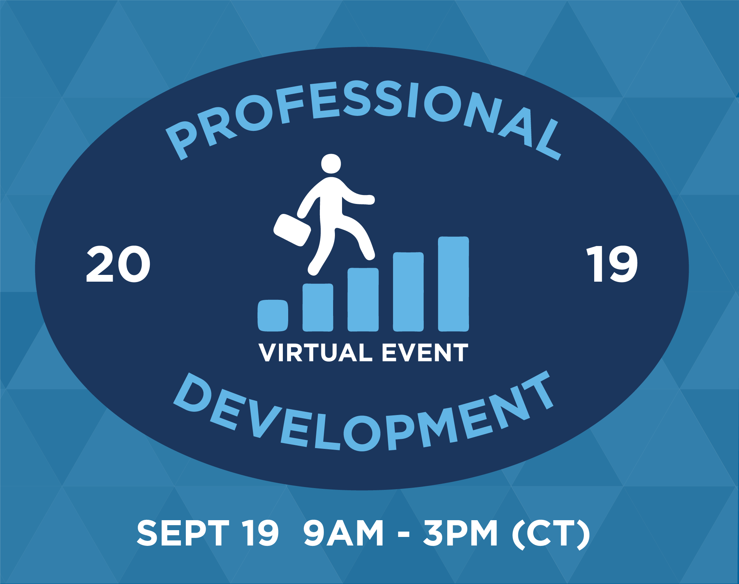
Wisdom I’ve picked up
Create and expand your professional network
Ask to be mentored
Develop your soft and presentation skills
VMUG career event
(watch on demand)

Slide 15
Managing your manager
Talk to your manager on how to work together
Consistently managers want:
1) Integrity
2) Speak up if there’s problems
3) Honor your commitments with quality
4) Respect others (golden rule, be on time, etc)
5) Admit mistakes and learn from them

Slide 16
The tech is not the number one priority
(From AnsibleFest) For hiring, value
a) soft skills
b) A mindset of innovation (adaptiveness to change, creativity, resourcefulness, being able to see problems from different perspectives)
c) Bringing solutions instead of pointing out problems, being action oriented

Slide 17
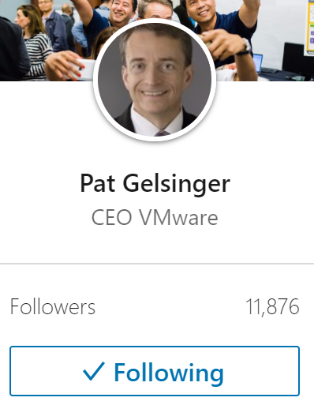
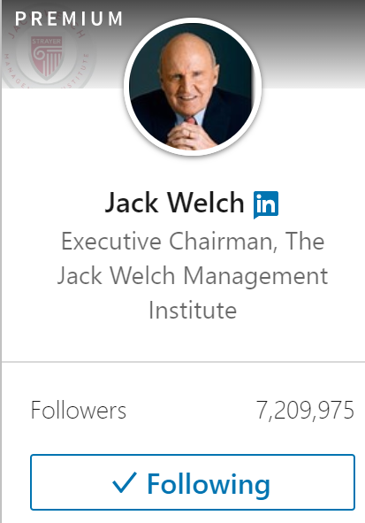
Social Media as a career tool
There are still those who think social media is just a waste of time
You can read on LinkedIn / Twitter lots of free articles from authors, IT leaders and CEOs

Slide 18
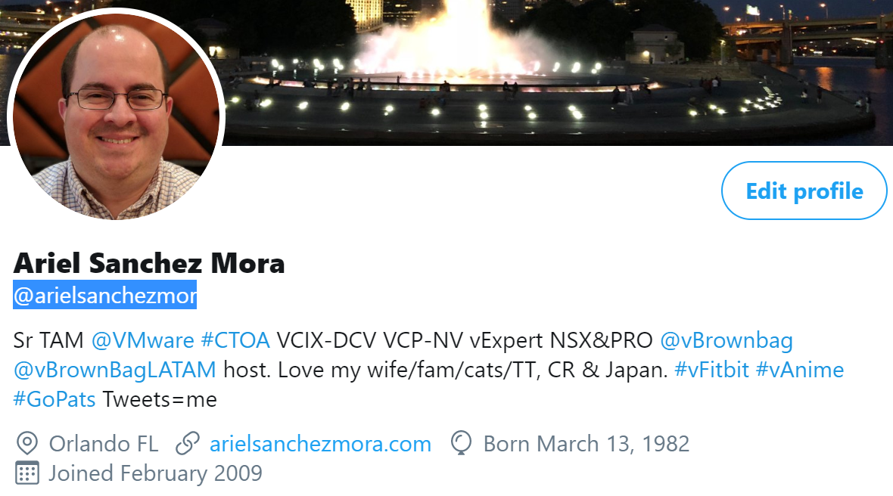
Twitter is where the vCommunity lives
Twitter: spreading info and short discussions
-global directory of people, lots of techies -‎hashtags are powerful!
#vExpert
#VCDX
#VMware
#vCommunity

Slide 19
Lots of ways to do vCommunity
VMTN forums
Reading and commenting on other’s blogs
LinkedIn/Facebook/Whatsapp/Telegram
Podcasts and webinars (Career ones: Geek Whisperers, vBrownbag)
Share and use code through Github/Gitlab
Assisting to VMUG and VMworld events
Slack chats like VMware Code

Slide 20
VMUG is HUGE
VMUG - reach out to the VMUG leaders, that they know who you are and offer them to present in the future
Leaders are so important to the vCommunity (hug em)
Hang out in the common areas and talk to others
Check twitter, there’s always a hashtag
Tailor the event so that you get what you want, but you also get pushed, and always be meeting people!

Slide 21
Easy ways to get better today
You feel you need to learn more?
Volunteer at work to help in the difficult projects
You’re learning just enough?
Take notes, sanitize the data for internet, and blog about it
Can’t really test and do stuff at work?
Homelab! HOL! VMUG Advantage is a great value and you get a discount today. Can be as cheap as you want

Slide 22
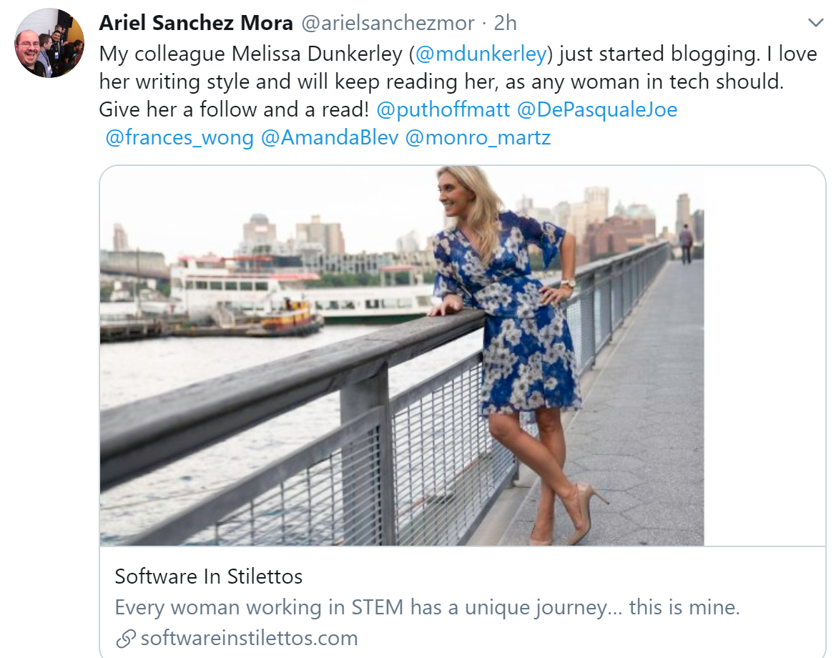
Don’t be afraid to do you
How do I start a blog?
$12 domains.google.com Blogger, wordpress.com, GitHub pages, Medium, etc
Melissa Dunkerley
@mdunkerley on Twitter
Bring your perspective

Slide 23
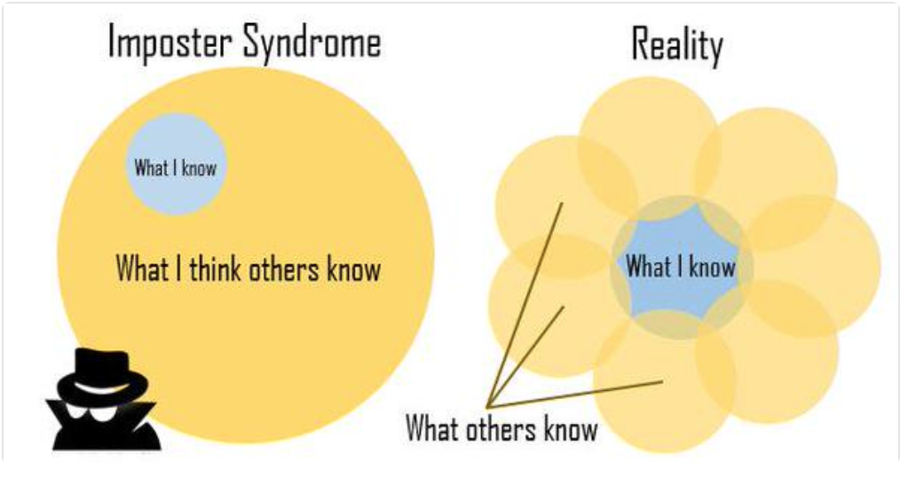
4 stages of participation
1 lurk
2 interact
3 ‎contribute
4 mentor
You will learn so much more from teaching others
Presenting itself is something that takes practice to do well
Just try to get better each time. That’s all!

Slide 24
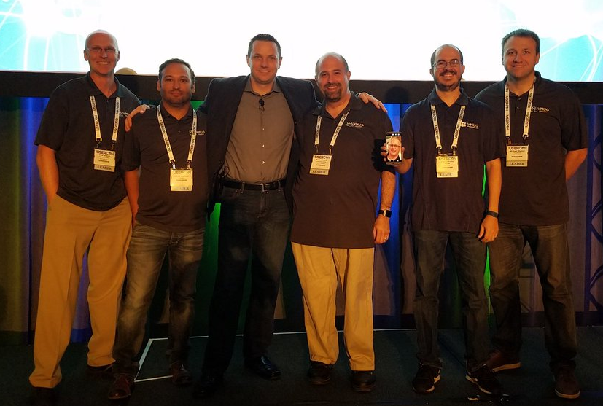
History with NYC
Gave the closing keynote last year
Anyone got into the vCommunity more since last year?
1st presentation was on the VCSA
2nd presentation was on Explaining NSX to a vSphere admin
Then became a VMUG leader
The went to VMware
I’m actually part of the NY team xD

Slide 25
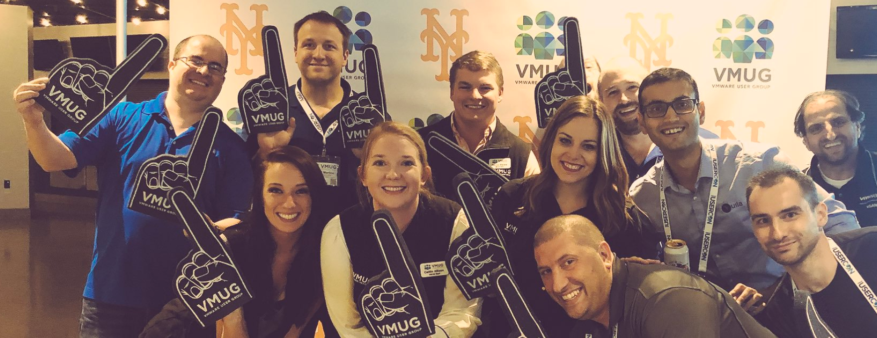
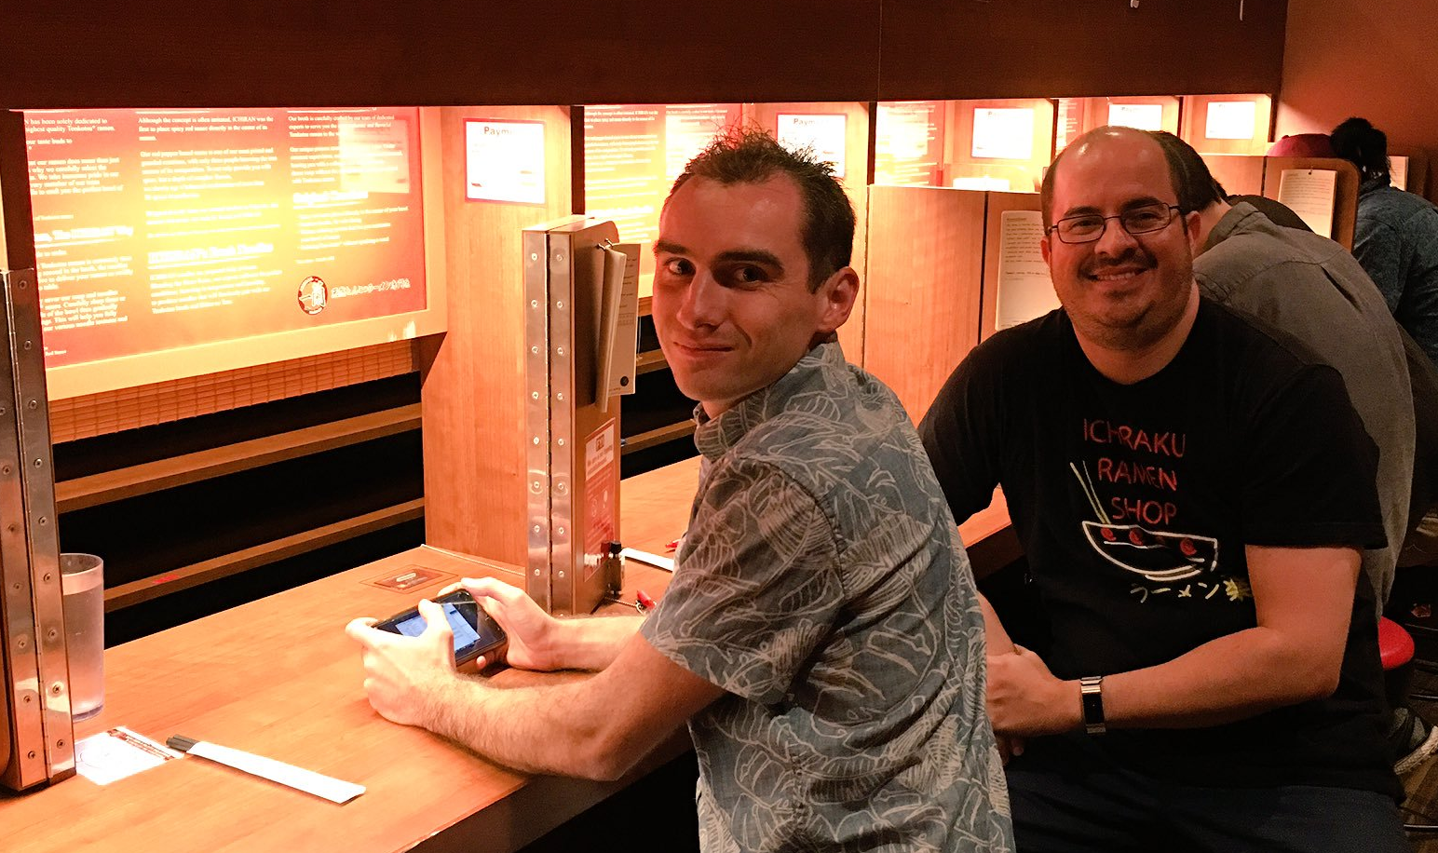
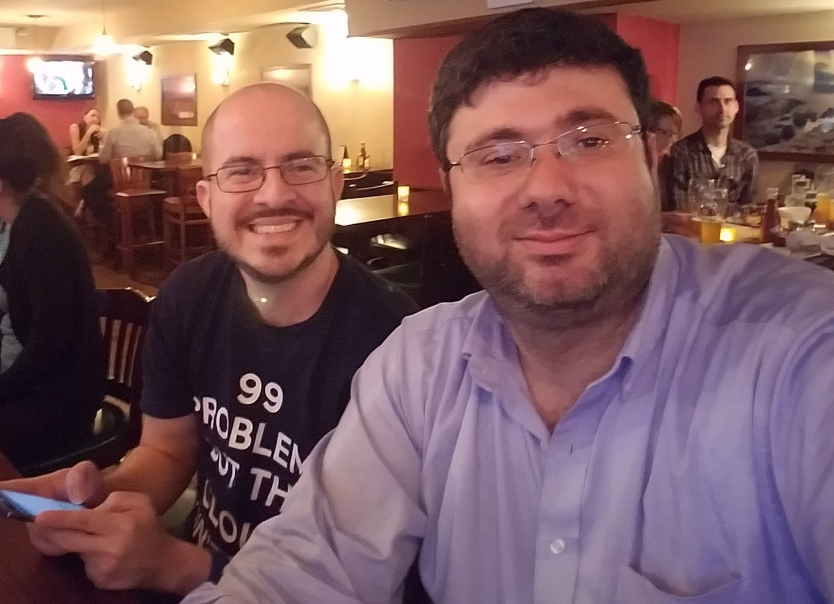
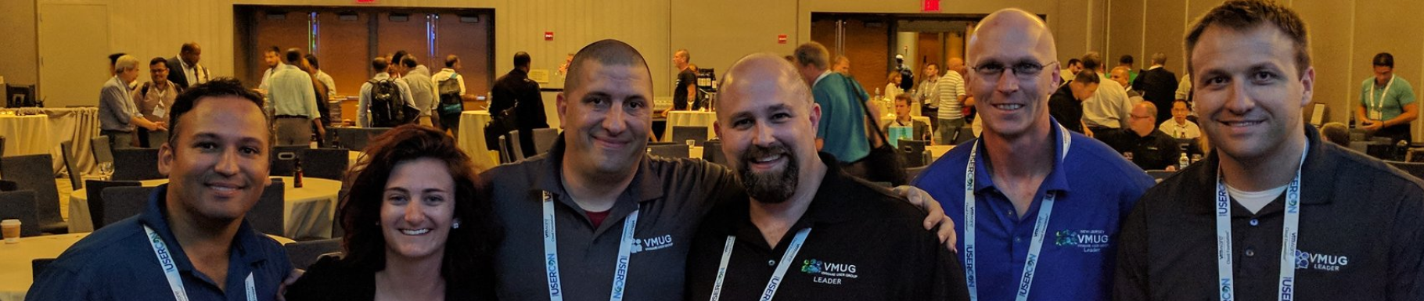
Things I miss about NYC
Ramen! And bagels! And good coffee!
Just walking around
But mostly, Friendships!

Slide 26
Advantages of living in NYC area
Talent you have access to
Frequency of meetups, conferences and adjoining events
A certain pride (swagger?) of surviving this city
24/7 transportation
Honestly, people are nice!
Talk to each other. Make friends. You will see them in other events and help each other learn and get introduced

Slide 27
Demo: how vCommunity makes your life easy
Want to change a little the conversation – let’s give you some knowledge you can use today
1) Free open source projects everyone should know
2) Explaining new tech in 5 minutes (Ansible & VMware)
3) Getting started on multi-cloud and Kubernetes

Slide 28
Document and analyze your environment
RVTools by Rob de Veij - https://www.robware.net/rvtools/ Windows SDK
vCheck started by Alan Renouf – emailed every day https://github.com/alanrenouf/vCheck-vSphere
vDiagram started by Alan and upgraded by Tony Gonzalez – Visio https://github.com/Tony-SouthFLVMUG/vDiagram2.0 2PM today!
As Built Report started by Tim Carman - PDF https://github.com/tpcarman/As-Built-Report

Slide 29
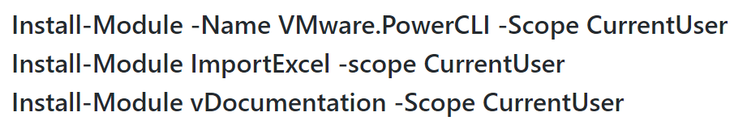
Document and analyze your environment
vDocumentation – most coding by Edgar Sanchez https://github.com/arielsanchezmora/vDocumentation
Useful to gather details like firmware/driver/syslog/ntp
Video: https://www.youtube.com/watch?v=H6Rq8Ocmodo

Slide 30
Getting started with Ansible & VMware
Ansible presentation
Slides and source code here https://github.com/arielsanchezmora/VMUG-Talks/tree/master/2018-06-12%20Minneapolis
Ansible, From zero to useful, full session https://www.youtube.com/watch?v=0_qwOKlBlo8
Lots of new tools use YAML for config files
YAML #1 tip: spaces & indentation are important! Don’t use tabs

Slide 31
What’s Ansible and why do I care
Ansible is open source software
Very flexible
Minimum requirements (no agents to deploy)
A mission to be simple to pick up
Enables infrastructure as code
Uses YAML because it aoms to be very readable

Slide 32
I do mean flexible
Ansible is an infrastructure management tool
It can interface with about everything with an API, or SSH!
Uses modules and plugins to interface
Lots of abstraction – what you do is really the minimum
Allows net/sys/devs/etc to collaborate in the same workflow

Slide 33
All installation commands
sudo yum update
sudo yum install python-setuptools
sudo easy_install pip
sudo pip install pyvmomi
sudo pip install ansible
That’s it (from a minimal install of CentOS)

Slide 34
Ansible in a nutshell
Ansible-playbook cmd executes a playbook
A playbook is just a yml file (text)
Playbooks define tasks in code “plays”
Tasks leverage modules to change inventory
Inventory can be in a file or gathered
Researching modules is the most time intensive task
Apart from troubleshooting ☺

Slide 35
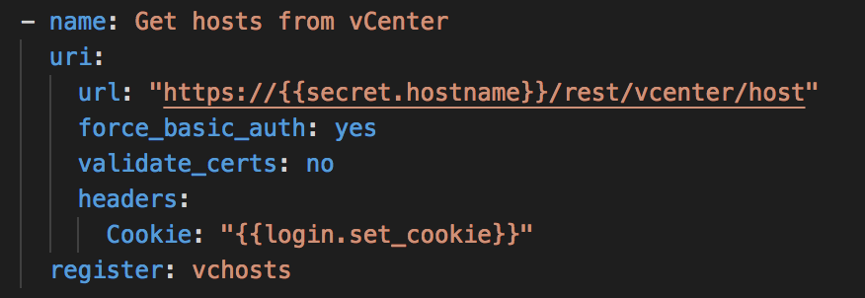
Get all the hosts in vCenter
Ansible URI module to interact with the VCSA REST API
JSON values returned

Slide 36
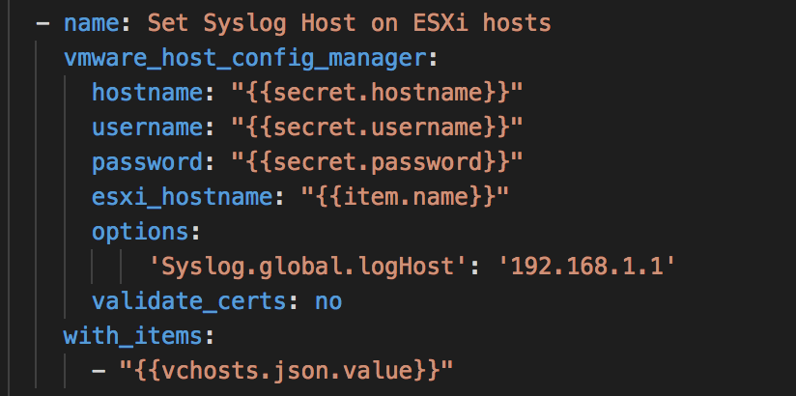
Set Syslog Host
Ansible Module (Uses pyVmomi SDK)
with_items: run the above on all values
{{item.name}} is variable containing each the esxi host name

Slide 37
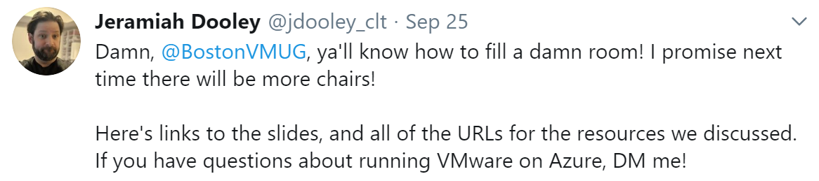
Getting started on multi-cloud and K8s
Jeremiah Dooley is giving a VMC on Azure deep dive session today at 1pm!
Daniel Ellis is giving an Architecture and Solution Design for VMC on AWS at 2pm!
If AWS / Azure is new, pro tip: learn the networking!

Slide 38
We all should be learning Kubernetes
Kubernetes is becoming the standard for managing containers in multi-cloud
Kubernetes difficulty is about understanding the concepts
https://kubernetes.io/docs/concepts/
Kubernetes accepts your “command” to create objects.
Every object it creates has a spec (what you want) and a status (what k8s has been able to do)
https://k3s.io/ on a Raspberry Pi is super quick to setup

Slide 39
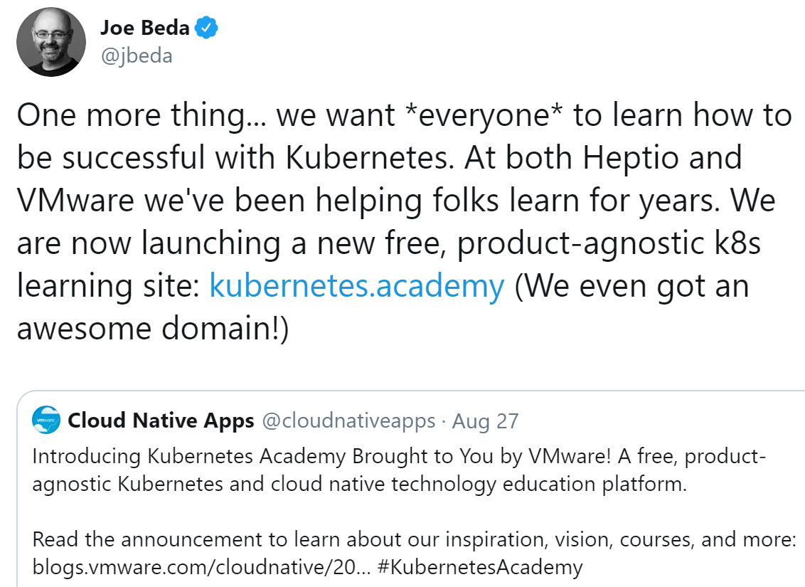
You can start today!
Also, today Thomas Kraus gives “Getting started with Kubernetes” at 1pm!

Slide 40
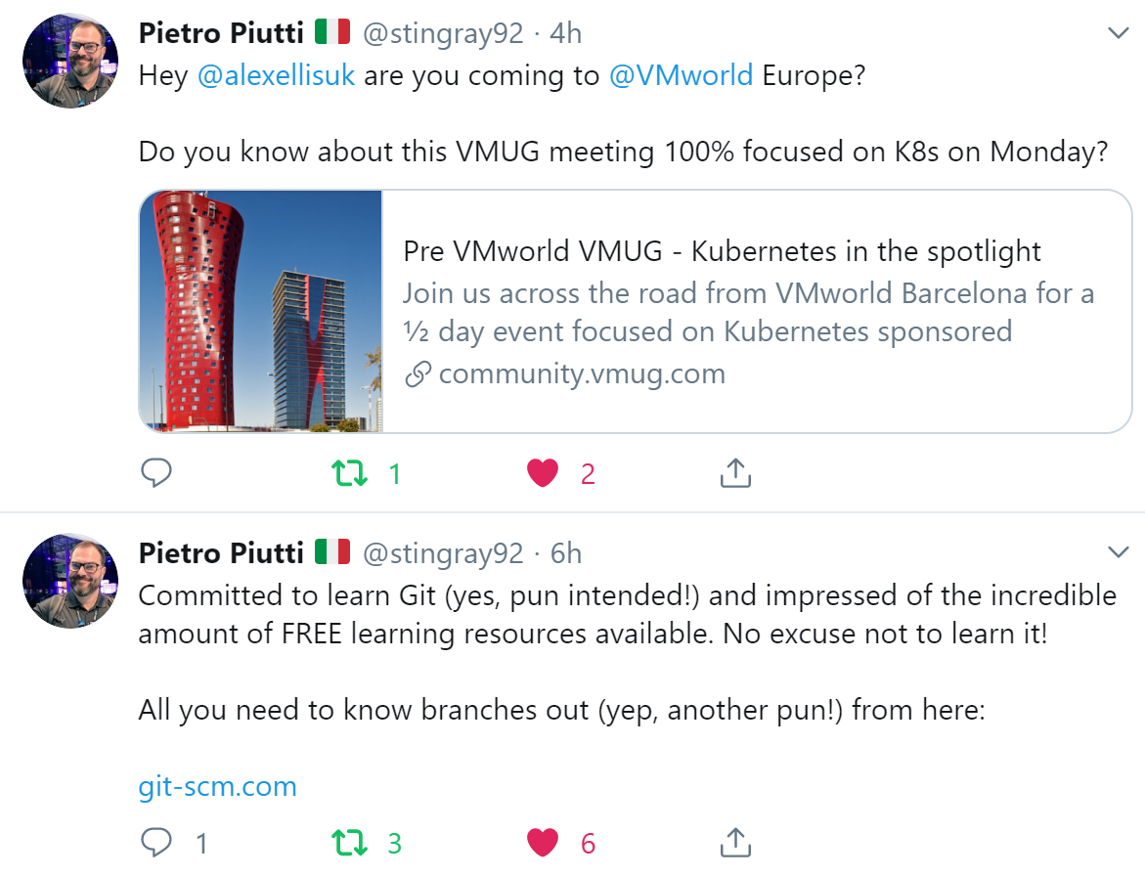
Anyone going to VMworld Europe?

Slide 41
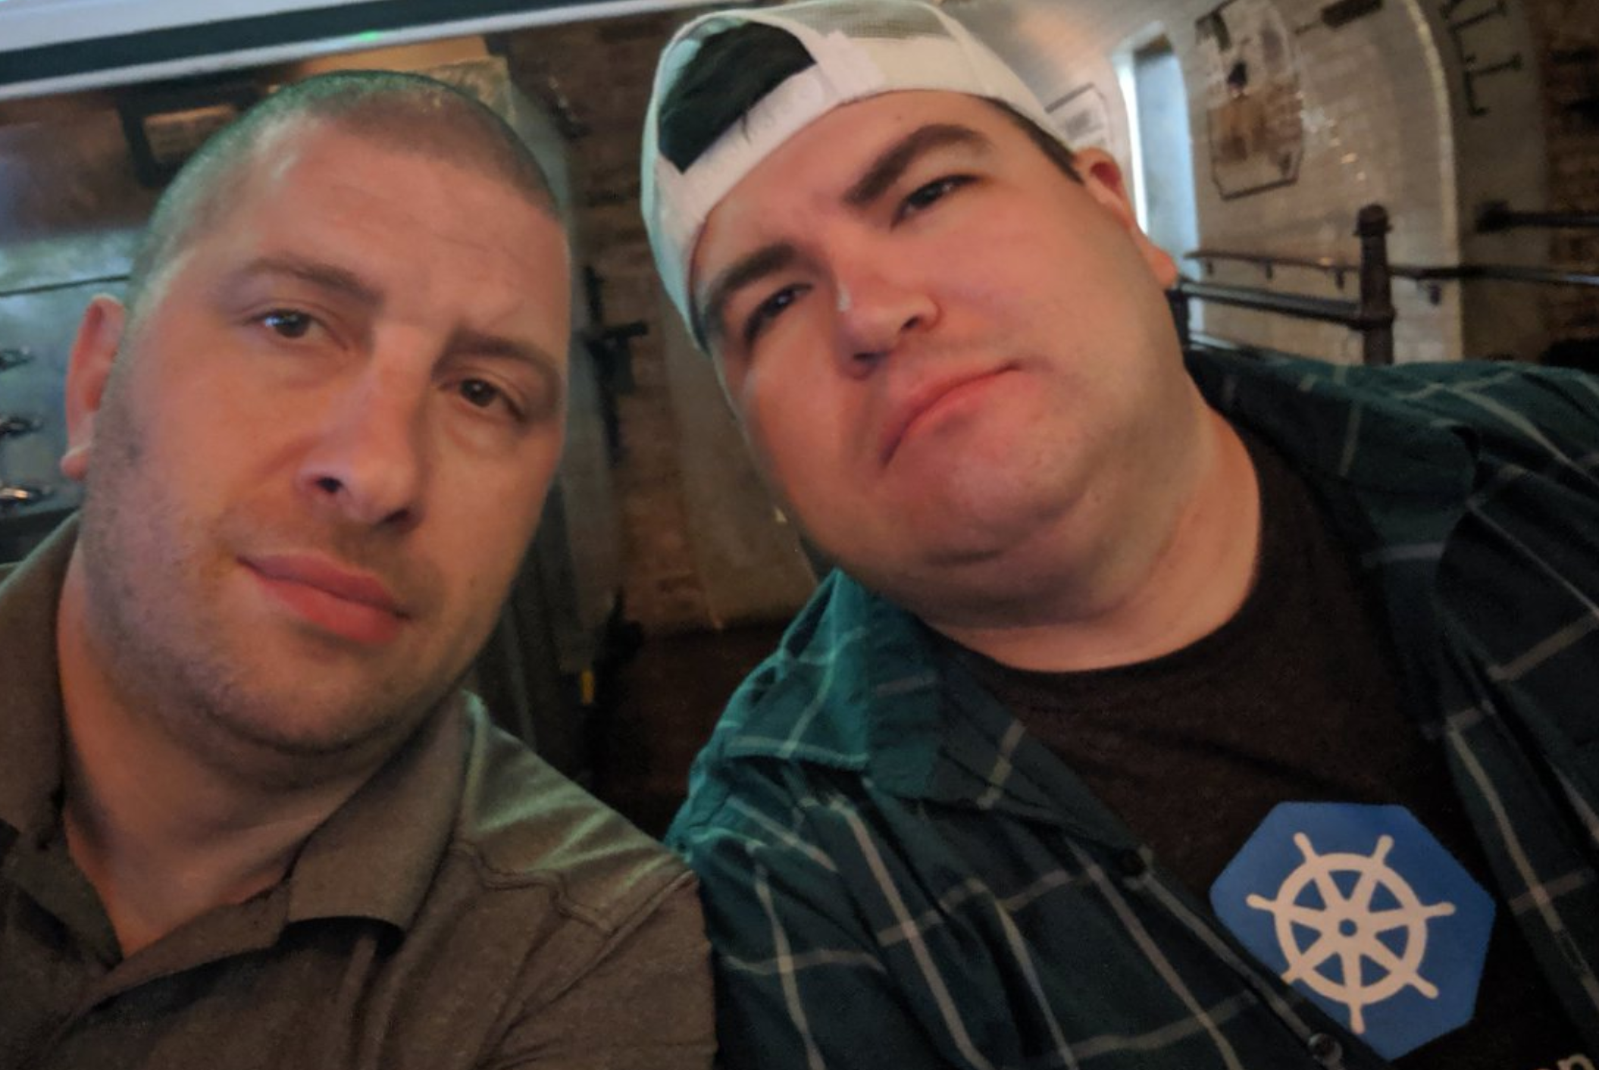
We’re done!
Last shoutout: Joe Houghes is giving “Being effective at Technical communication” at 4pm)
#NYNJVMUG
@arielsanchezmor
See you in twitter ☺

